Slide 1
Student Council-Virtual Stormont tour

Slide 2
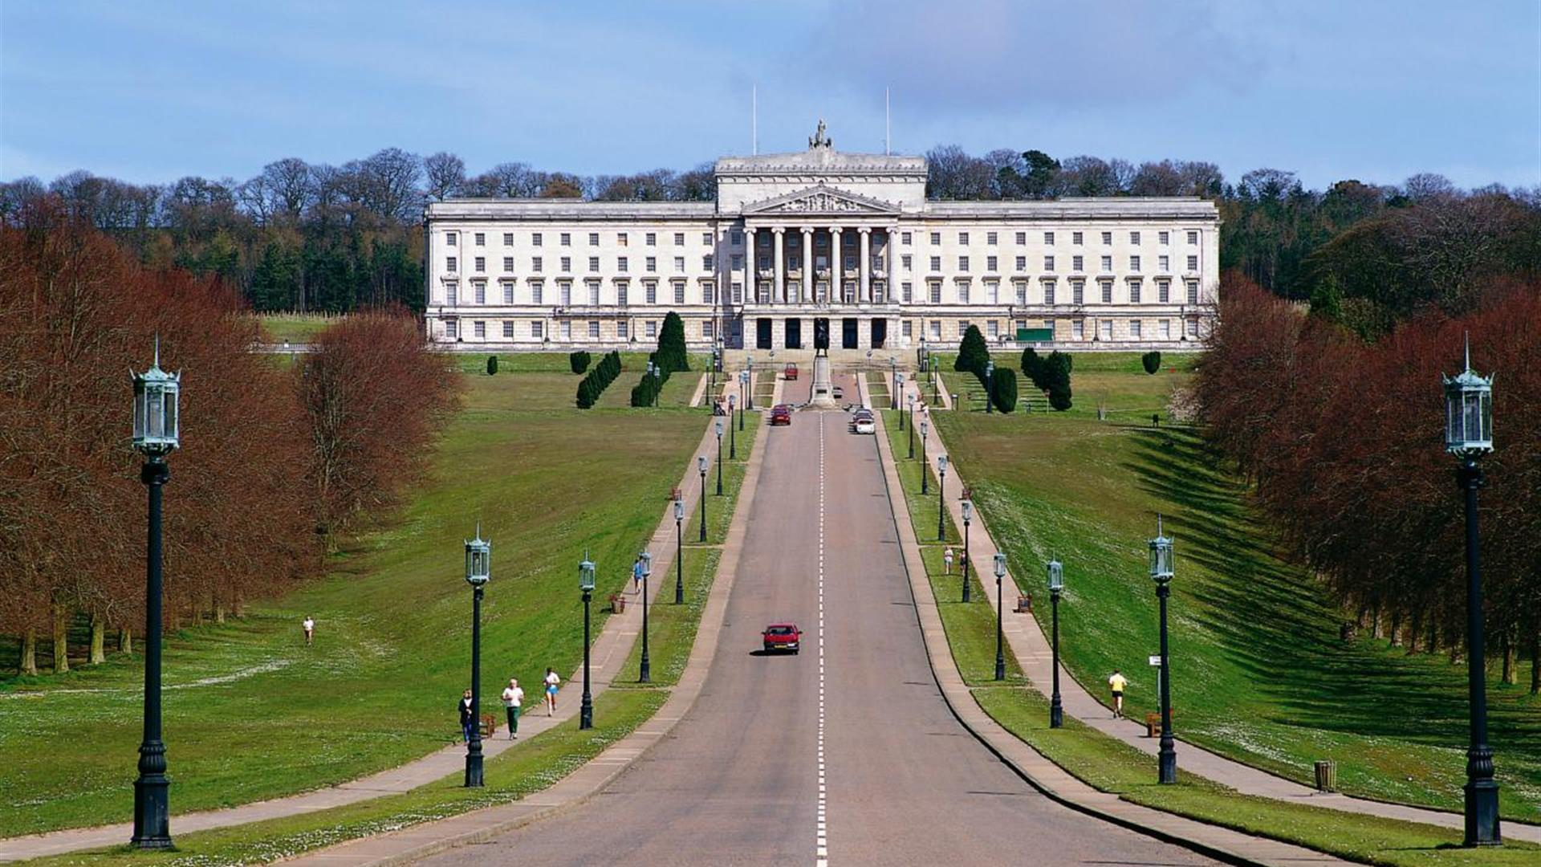

Slide 3
Student Council-Virtual Stormont tour
The student council participated in a virtual tour of Stormont.
We learnt about how our country is run, who makes our decisions and how this relates to us, the Student Council-the leaders of our school community.
In this presentation we have shared our thoughts from this experience.

Slide 4
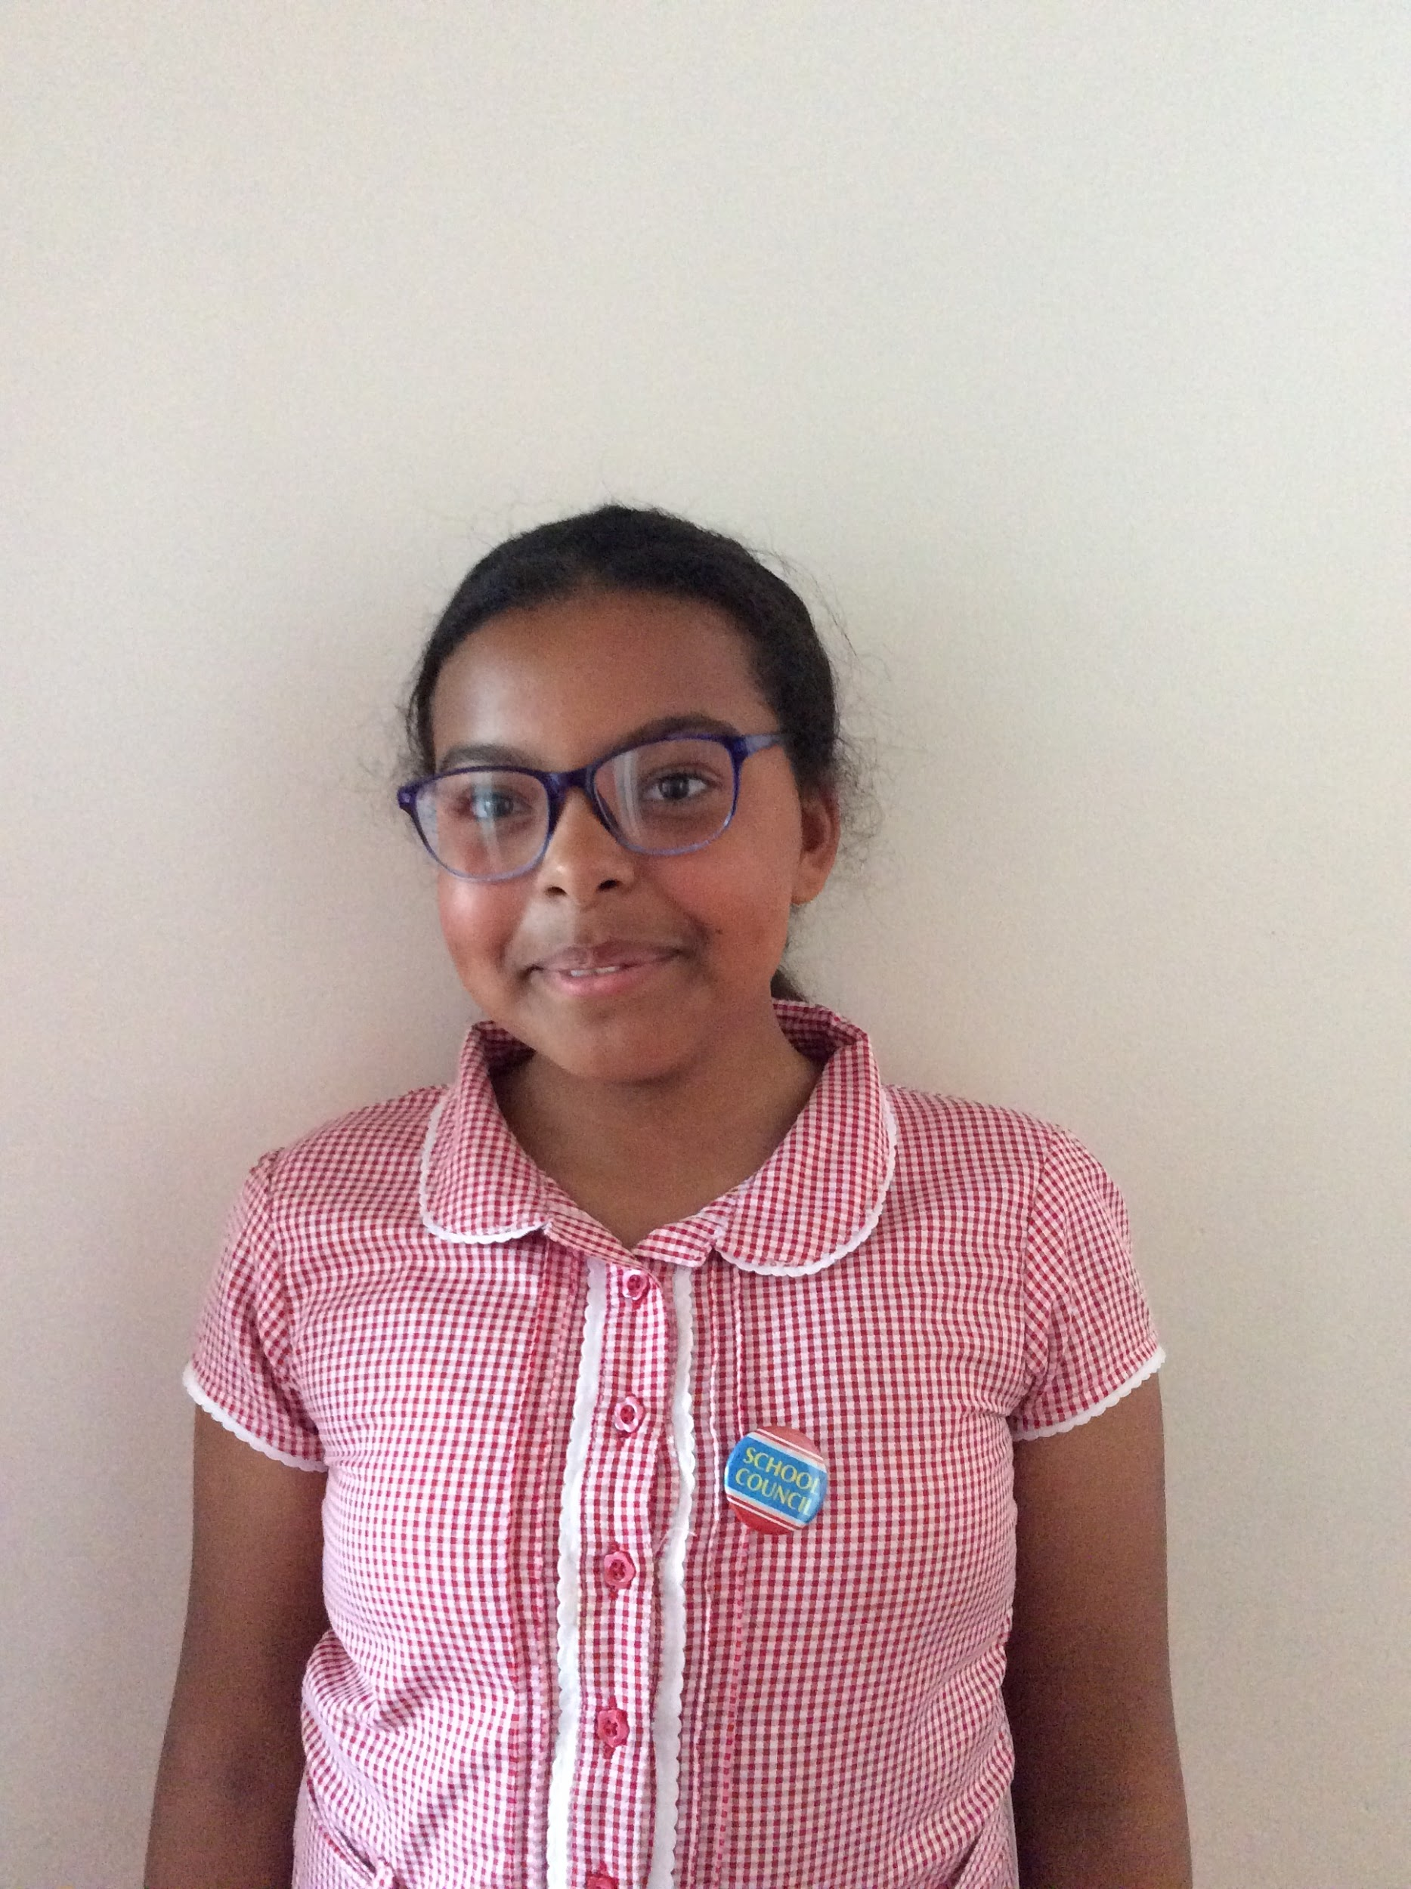
Jessica
I learnt that there is 90 MLA’s
I loved how we talked about what some MLA’s do. Their job sounds so fun but I think it would be a hard job. They discuss new laws, such as food hygiene and speed limit laws outside schools.
I loved how we got to ask questions at the end of the virtual meeting. I learnt so much information and had a great time. I was able to present to my class what I had learnt.

Slide 5
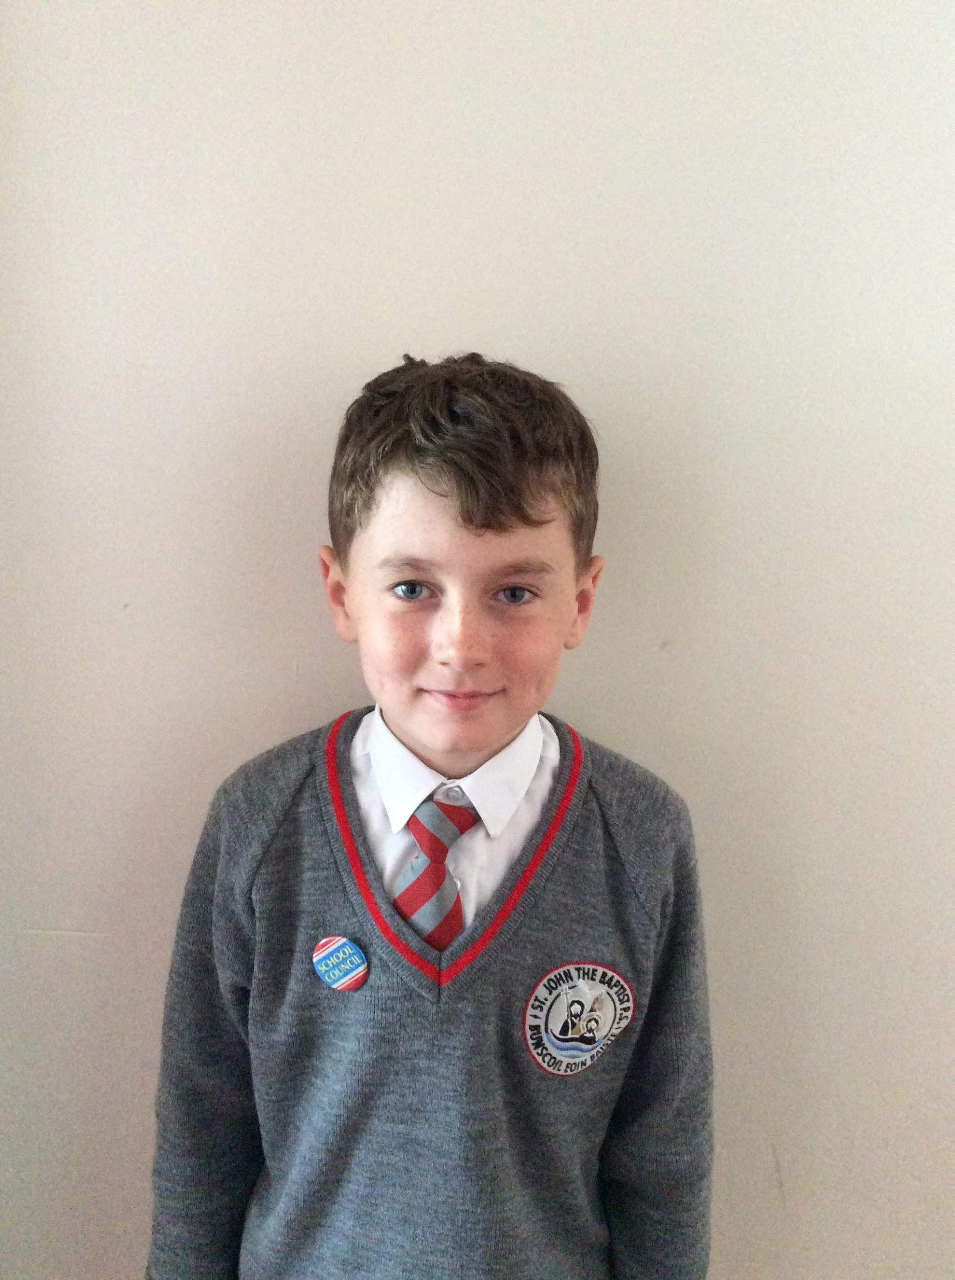
Ashtin
I had great fun at our Student Council meeting. It was different than usual, as we had the opportunity to speak to a lady who told us lots of information about MLA’s and the work they do.
I learnt about the voice of an MLA, this is like how we represent the pupil voice of our school.
I also learnt about the 20mph limit which some schools have introduced. This makes it safer for children coming to and home from school.

Slide 6
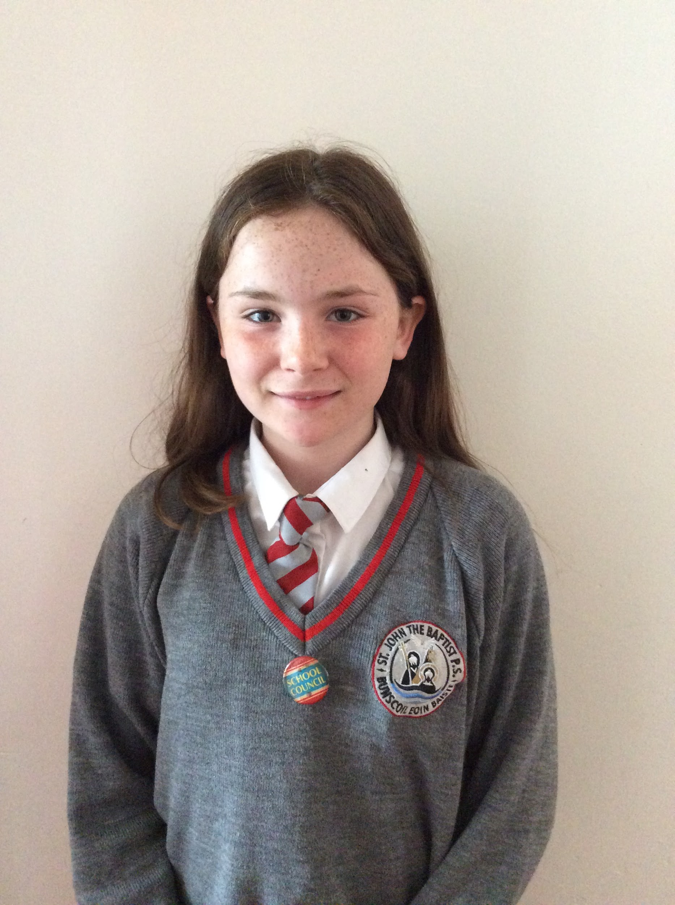
Áine
I learnt that to make laws people need to vote and to do that they split up and cheer for their side. The side that sounds the loudest wins.
I loved learning about how they make laws.
I loved when we got to make decisions as if we were a MLA. This was so fun!

Slide 7
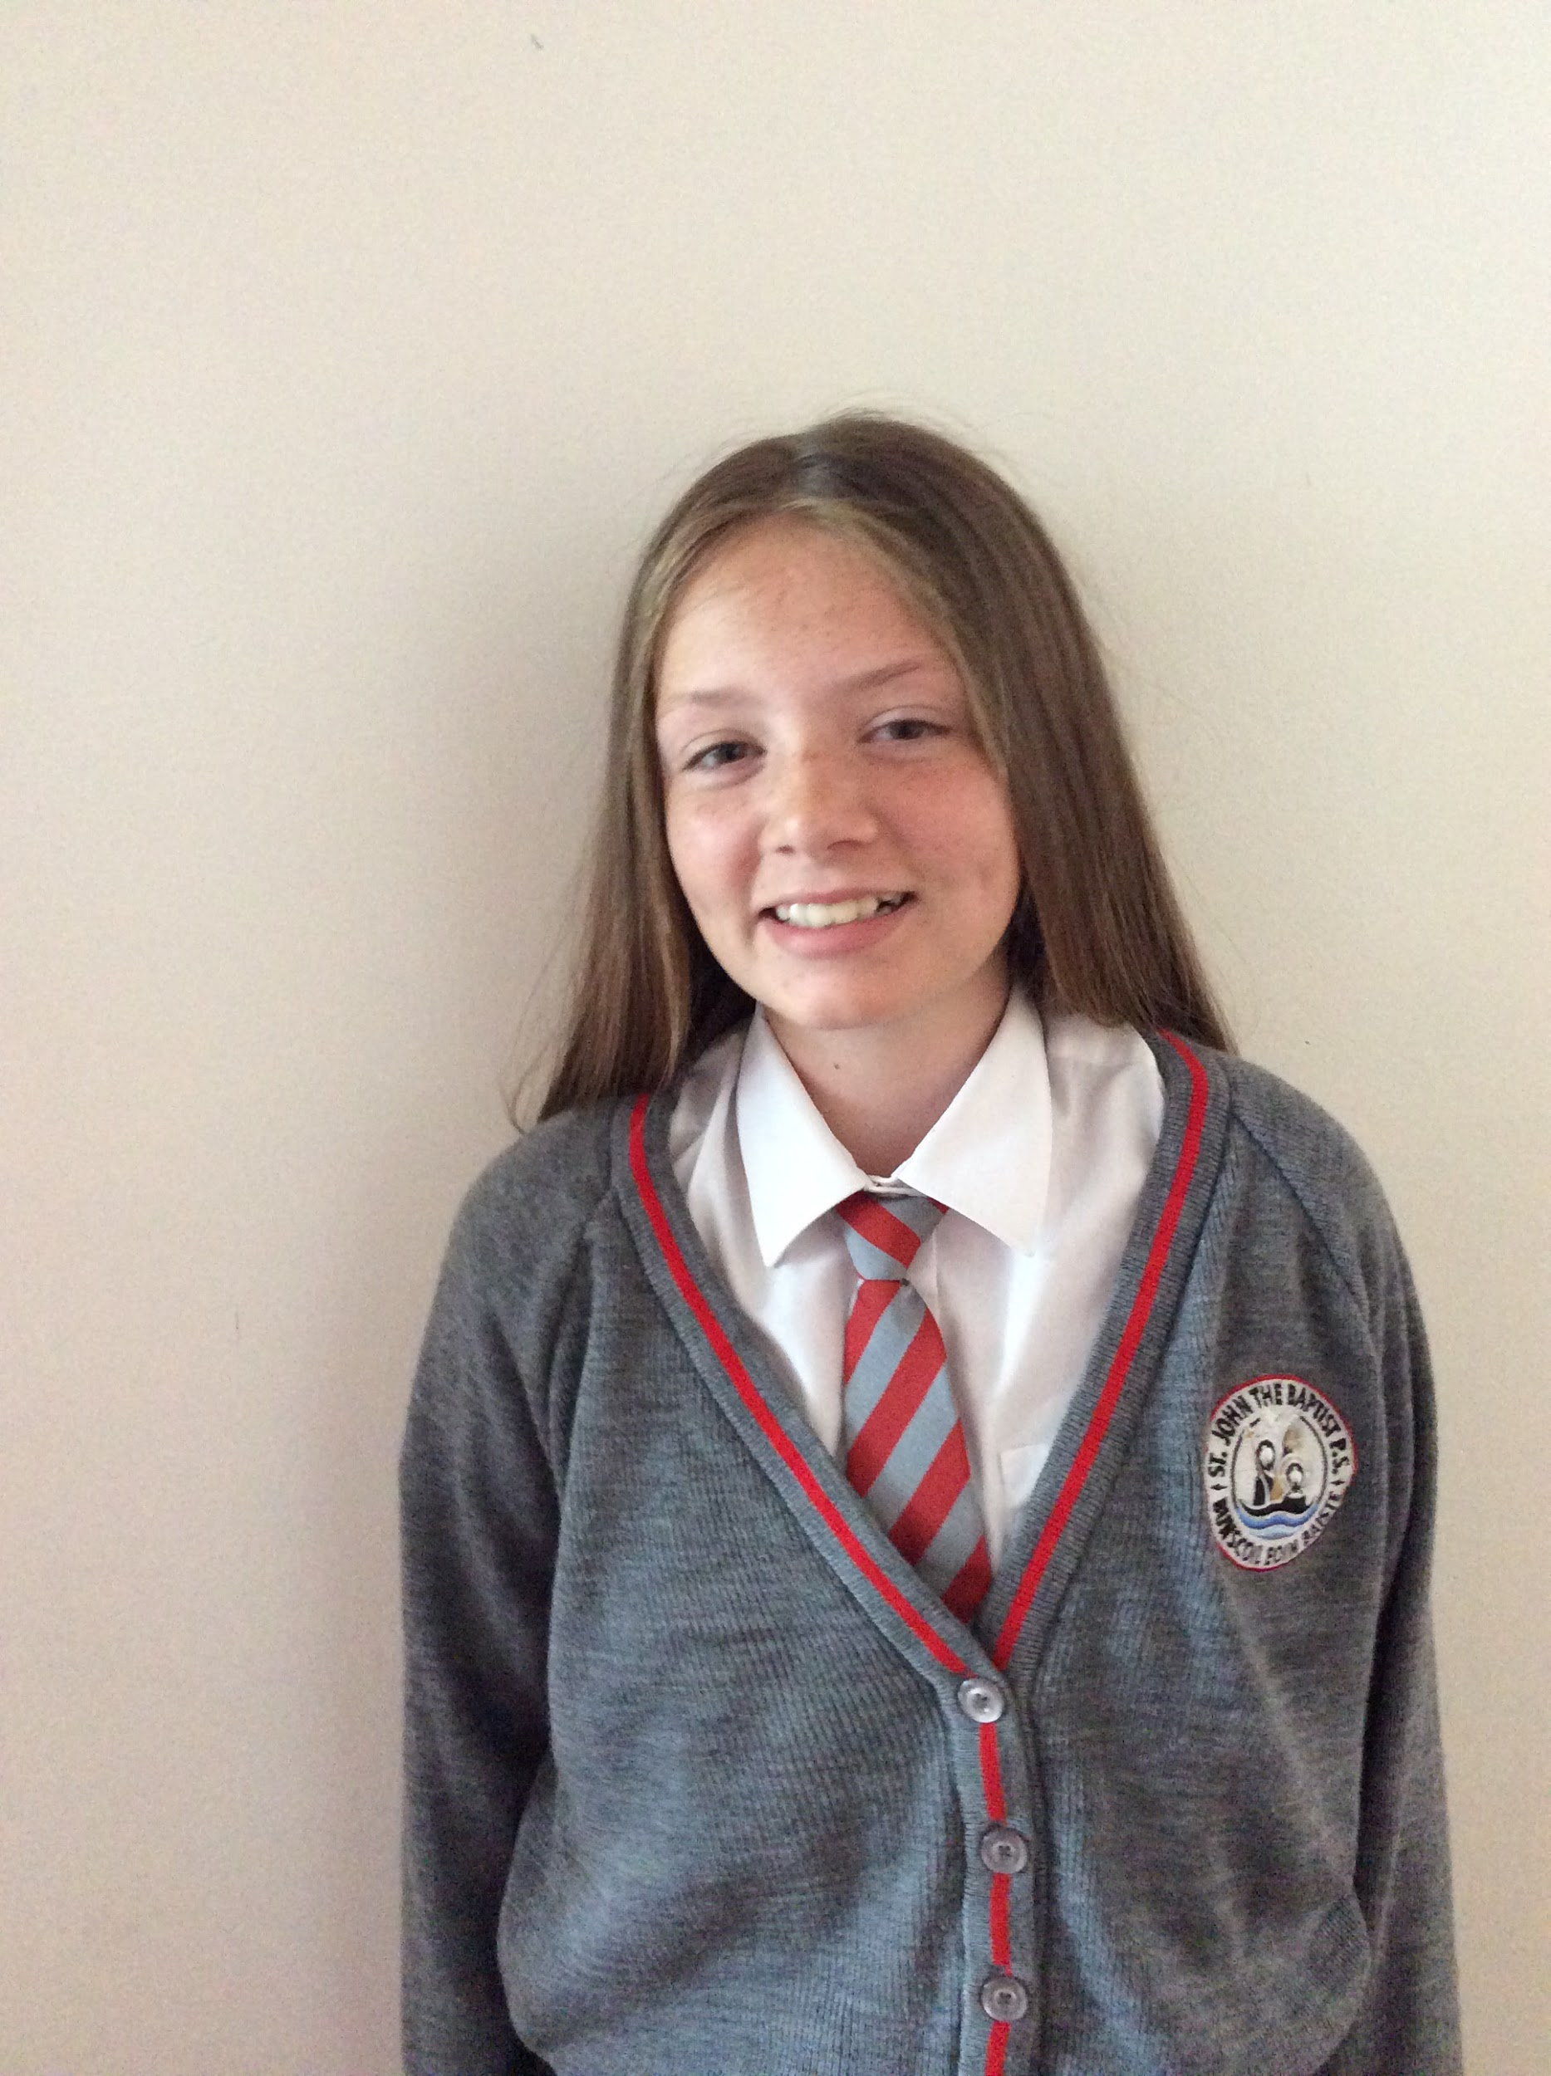
Melah
Our Virtual trip to Stormont was really interesting. We found out about local MLA’s and how they do their job. It’s a little like how we represent our school community as the pupil voice.
I enjoyed listening about how the MLA’s do their job.
We also completed a virtual vote and I really enjoyed discussing the matters raised in the student council.

Slide 8
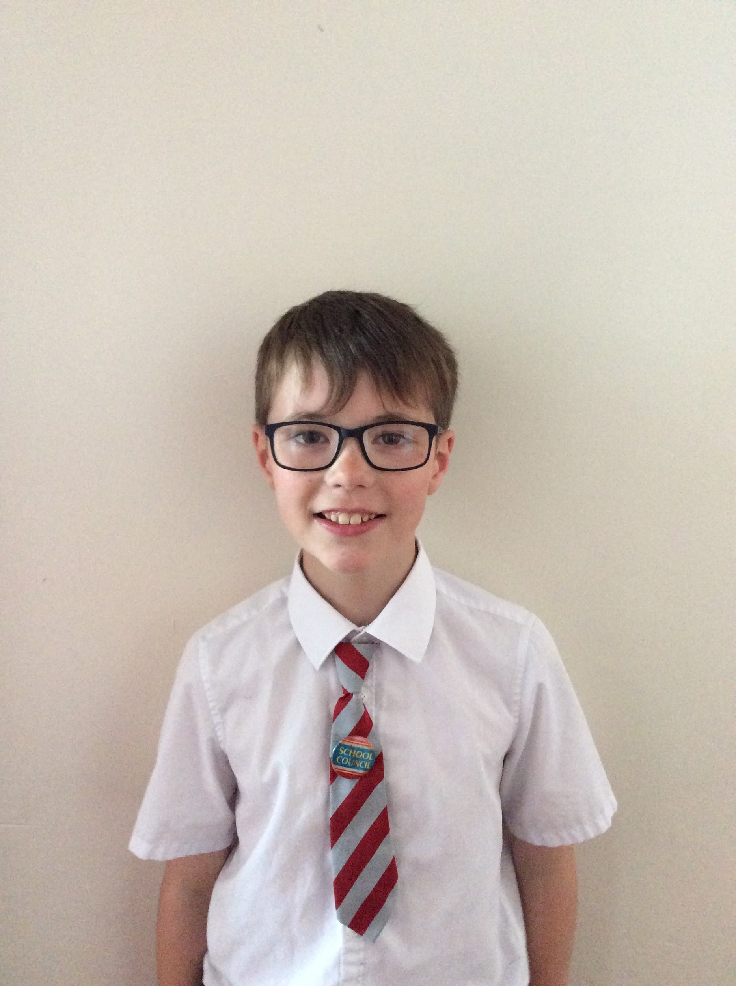
Jude
I learnt that there are 90 MLA s (Members of the Legislative Assembly). There are 5 MLAs for each area. E.G Armagh, Banbridge, Craigavon (Which includes Portadown.)
I enjoyed getting to find out how the MLAs make big decisions. I also enjoyed learning the rules they decide on and how this process works.

Slide 9
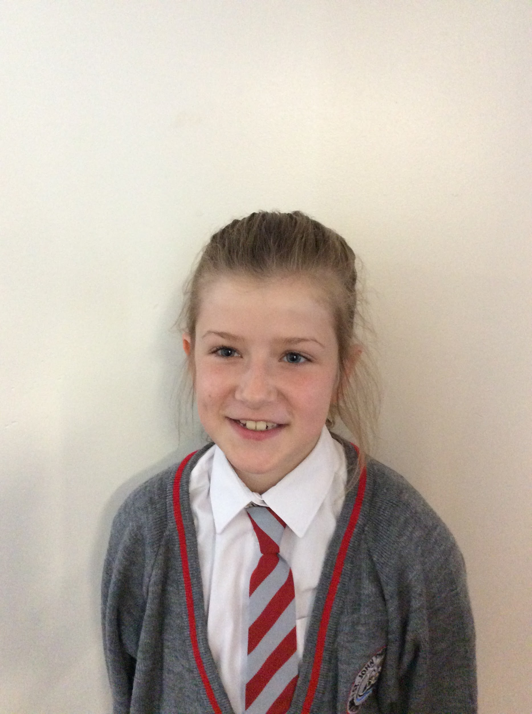
Meabh
I really enjoyed learning about Stormont, especially about how laws are passed-they go by the volume of the voices present. If the volume is the same-the MLA’s walk left or right down a corridor and are counted.
We had a pretend vote on school uniforms. EVERYONE said ‘no’ when the lady asked did we want school uniforms. I was so surprised!

Slide 10
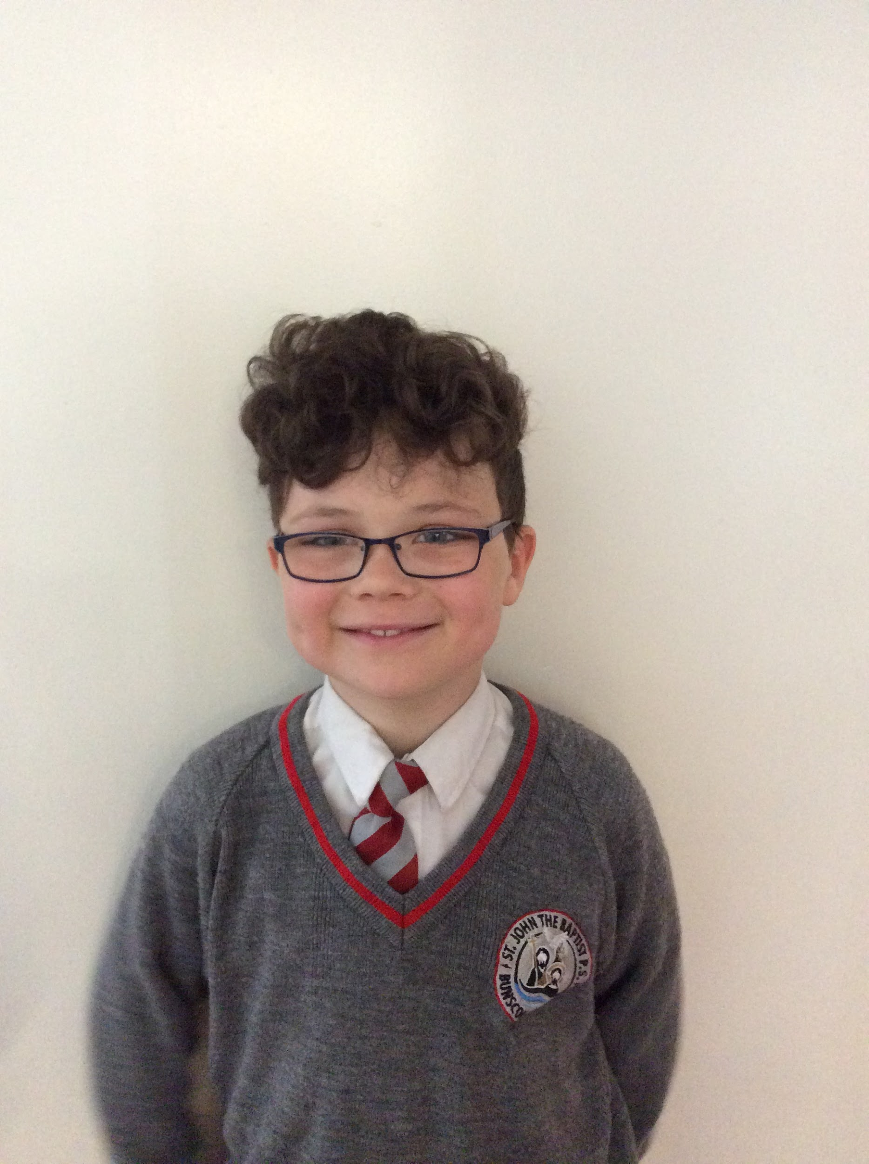
Finnian
I enjoyed learning about how the government in Stormont work, how they make decisions which impacts our country.
I liked learning about all of the ministers, especially about our local MLA’s. I didn’t know that anyone, even children could approach an MLA with a concern or issue.
I had great fun on our virtual tour to Stormont.

Slide 11
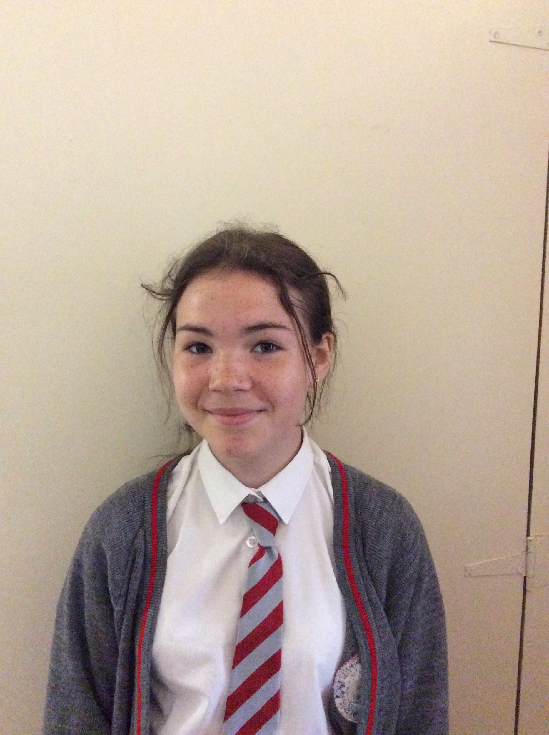
Mia
I really enjoyed our virtual trip to Stormont.
I learnt that they made the law of the 20 speed signs outside some schools
I also learnt that when they are making laws sometimes they find it hard to choose the decision.
When they are making laws a man/women acts as a speaker and asks the MLAs to pick a side. The people who want this law say ‘I’ and those who don’t say ‘No’. They see which was louder but sometimes they can’t tell so they ask them to go down the halls and then they count and then that’s the decision made!I found this super interesting!

Slide 12
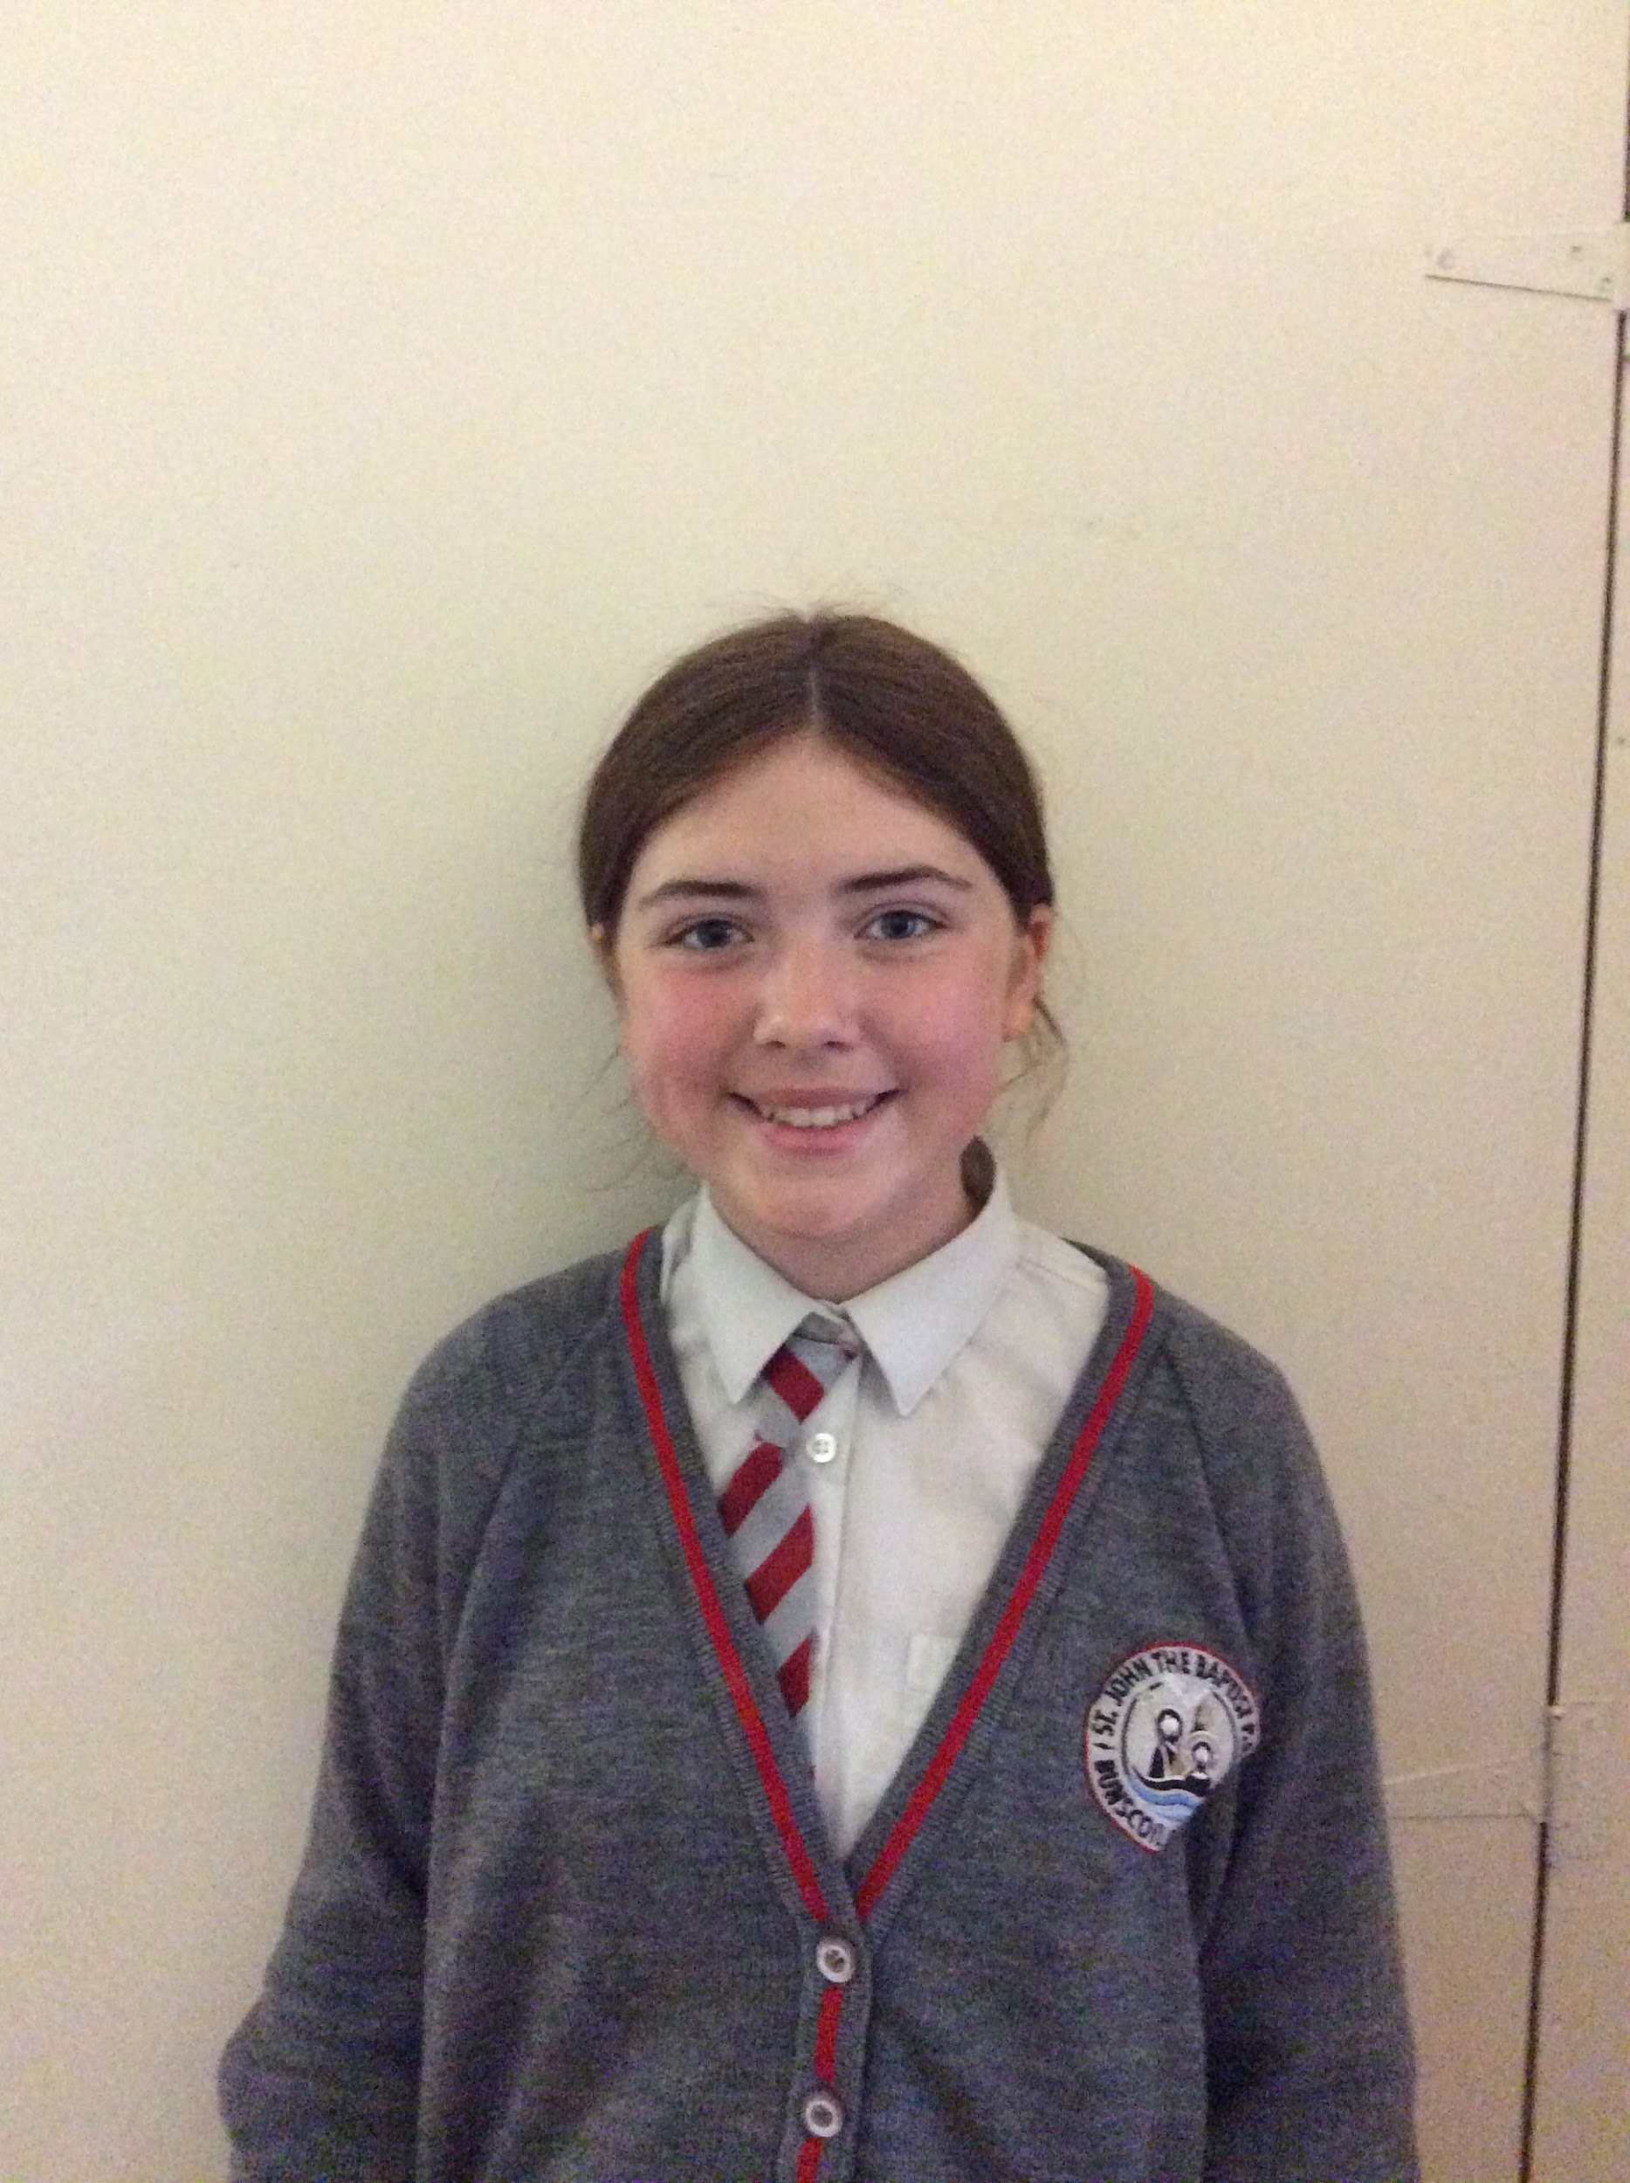
Aoise
I learnt that there are 90 MLA’s (Members of the Legislative Assembly) 5 from each 18 constituencies.
Stormont has power sharing which means that contentious motions need cross community support to be passed.
To make laws an MLA can bring forward a motion and they tell all of the other MLA’s why they think the law is needed. There is a vote to see if it should pass. Everyone who wants the law to pass goes to one side of the hall/room and the MLA’s that don’t go to the other side. If the yes vote is a majority, the law is passed. I would love this job, although I think it would be a difficult job.

Slide 13
We hope you enjoyed reading our Virtual Stormont trip reflections.
We had a great time learning about Stormont and sharing our thoughts with you all.

